Slide 1
Automobile CO2 Emissions
Sachin Jalan

Slide 2
Questions That Matter
Which factors affect the CO2 emissions from vehicles?
Can we measure how such factors influence the emission of CO2 particles?
The road transport sector accounts for about 80% of the whole energy demand required by transportation. But due to its heavy reliance on fossil fuels, it also transmits the most amount of Green House gases.
Can we get some insights about which vehicles are comparatively more ‘eco-friendly’ and which are not?
Which vehicles contribute most to green house gas emissions?

Slide 3
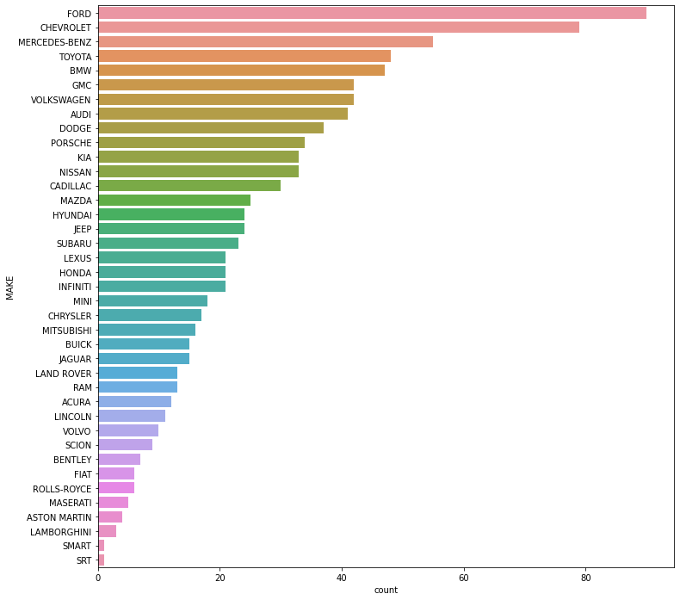
Vehicle Makes
Out of the 39 varieties of cars, Ford (90), Chevrolet (79), Mercedez-Benz (55) and Toyota (48) are most common.
9.5% of the dataset contains the data only from Ford Cars.

Slide 4
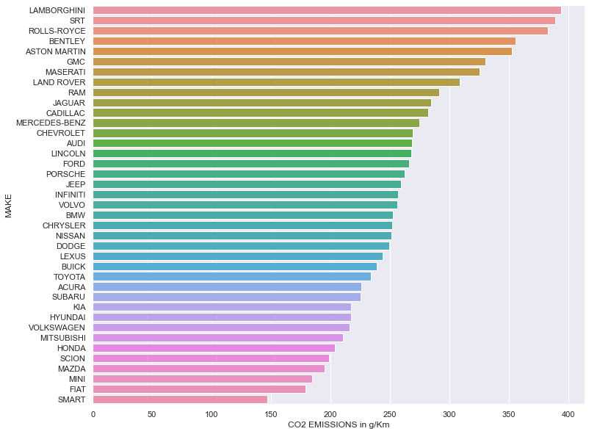
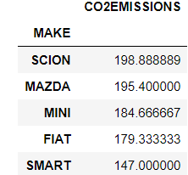
CO2 Emissions
Most polluting brands are all the high end ultra-luxury vehicles.
Least polluting car brands, typically associated with economic living.

Slide 5
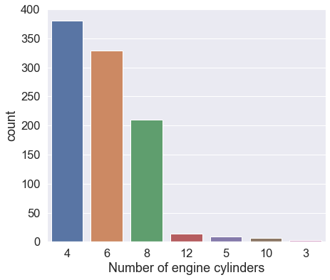
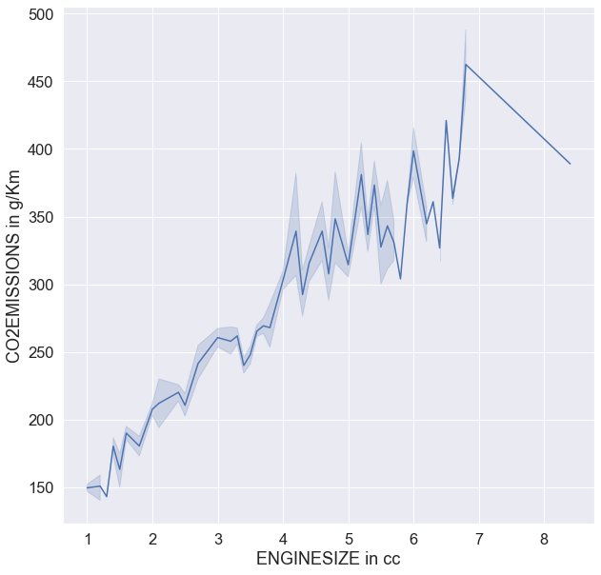
Engines & Cylinders
Out of the 7 varieties of cylinders, 4, 6 and 8 are very common cylinder types. About 97% of the data contains only these cylinder types.
We can see that with increase in engine size, CO2 emissions increase

Slide 6
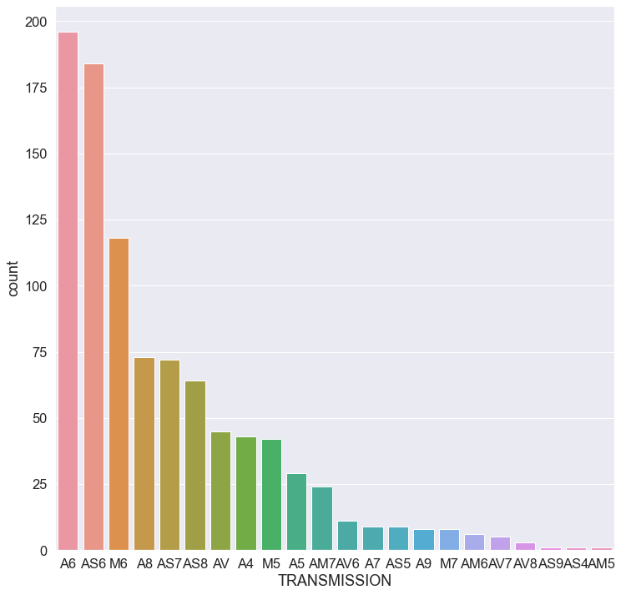
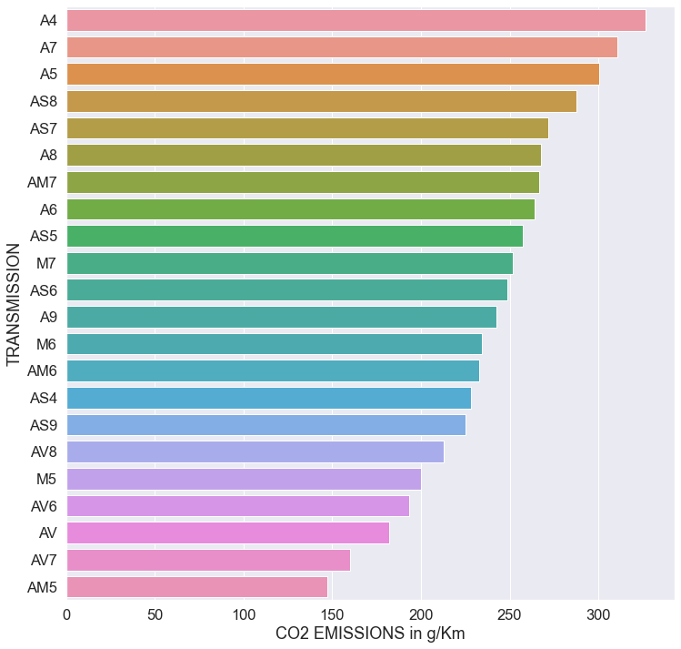
Transmissions
A6, AS6 and M6 are the preferred transmissions
Most polluting transmissions are A4, A7 and A5 which are not the preferred ones

Slide 7
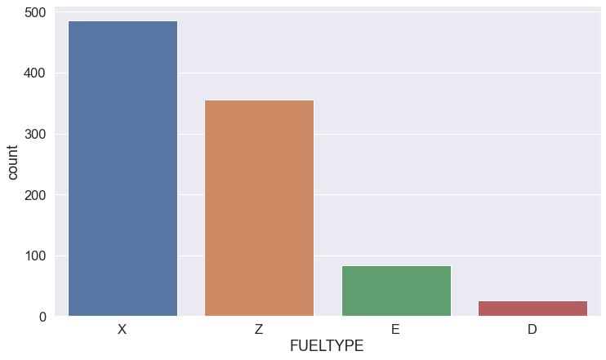
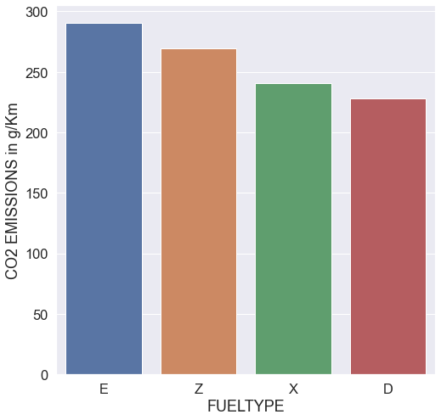
Fuel
Fuel type X and Z are most preferred
Fuels E and Z pollute the most, whereas fuel D the least
*Fuel E is less efficient hence not commonly used

Slide 8
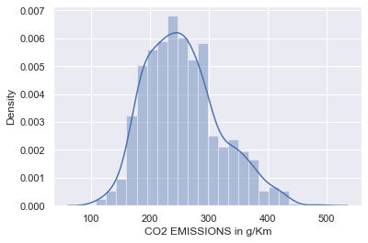
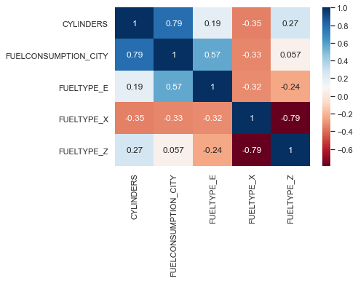
Regression
All 4 assumptions of Linear Regression satisfied:
Normal Distribution of Target Variable (CO2 Emissions)
Explanatory variables not co-related with each other
Linear Relationship between dependent and independent variables
Homoscedasticity (since other 3 are satisfied)
*FUELCONSUMPTION_CITY got saved by 0.01

Slide 9
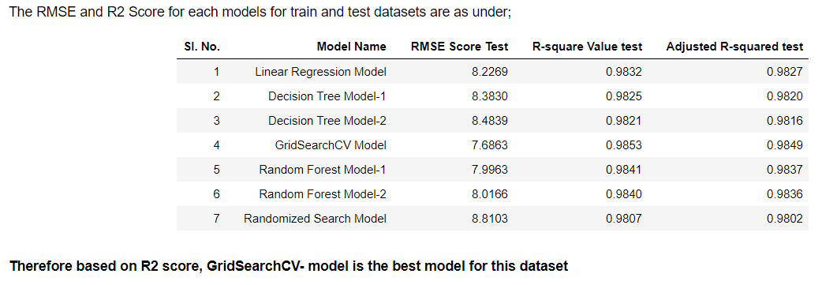
Conclusion
CO2 Emissions = 132.86+6.52['CYLINDERS']+463.10['FUELCONSUMPTION_CITY']-135.89['FUELTYPE_E']-24.65['FUELTYPE_X']-26.87*['FUELTYPE_Z’]
The CO2 Emissions are highly dependent on Fuel Consumption. For one unit increase in fuel consumption, the CO2 emissions increases by 463 counts.
The CO2 Emissions are also dependent on the number of engine cylinders. The CO2 emissions will get increased by 6.52 counts.
The use of different types of fuel always tend to reduce the CO2 emissions. Basically the Fuel type E has very high effect on reducing the CO2 emissions as it reduces the CO2 emissions by 136 counts.

Slide 10

Thank You

